Slide 1

ISIS Name Change
June 2022 ISIS TC Meeting

Slide 2

Why change the name?
Poll results
Recommendation
Impact
Recommended actions
Outline
ISIS TC Name Change Working Group
Jesse Mapel
Lori Pigue
Lauren Adoram-Kershner
Laszlo Kestay
Audrie Fennema
Victor Silva
Stuart Robbins

Slide 3
Why are we considering a name change?
The USGS has been aware of anecdotal reports of issues with the name “ISIS” because of linkages to the terrorist group. A few are quite serious in nature, affecting some persons’ ability to travel and work.
We conducted a poll requesting internal and community input on whether the name should be changed and other concerns regarding a potential name change. We have analyzed poll results to attempt to gather more systematic information on this.

Slide 4
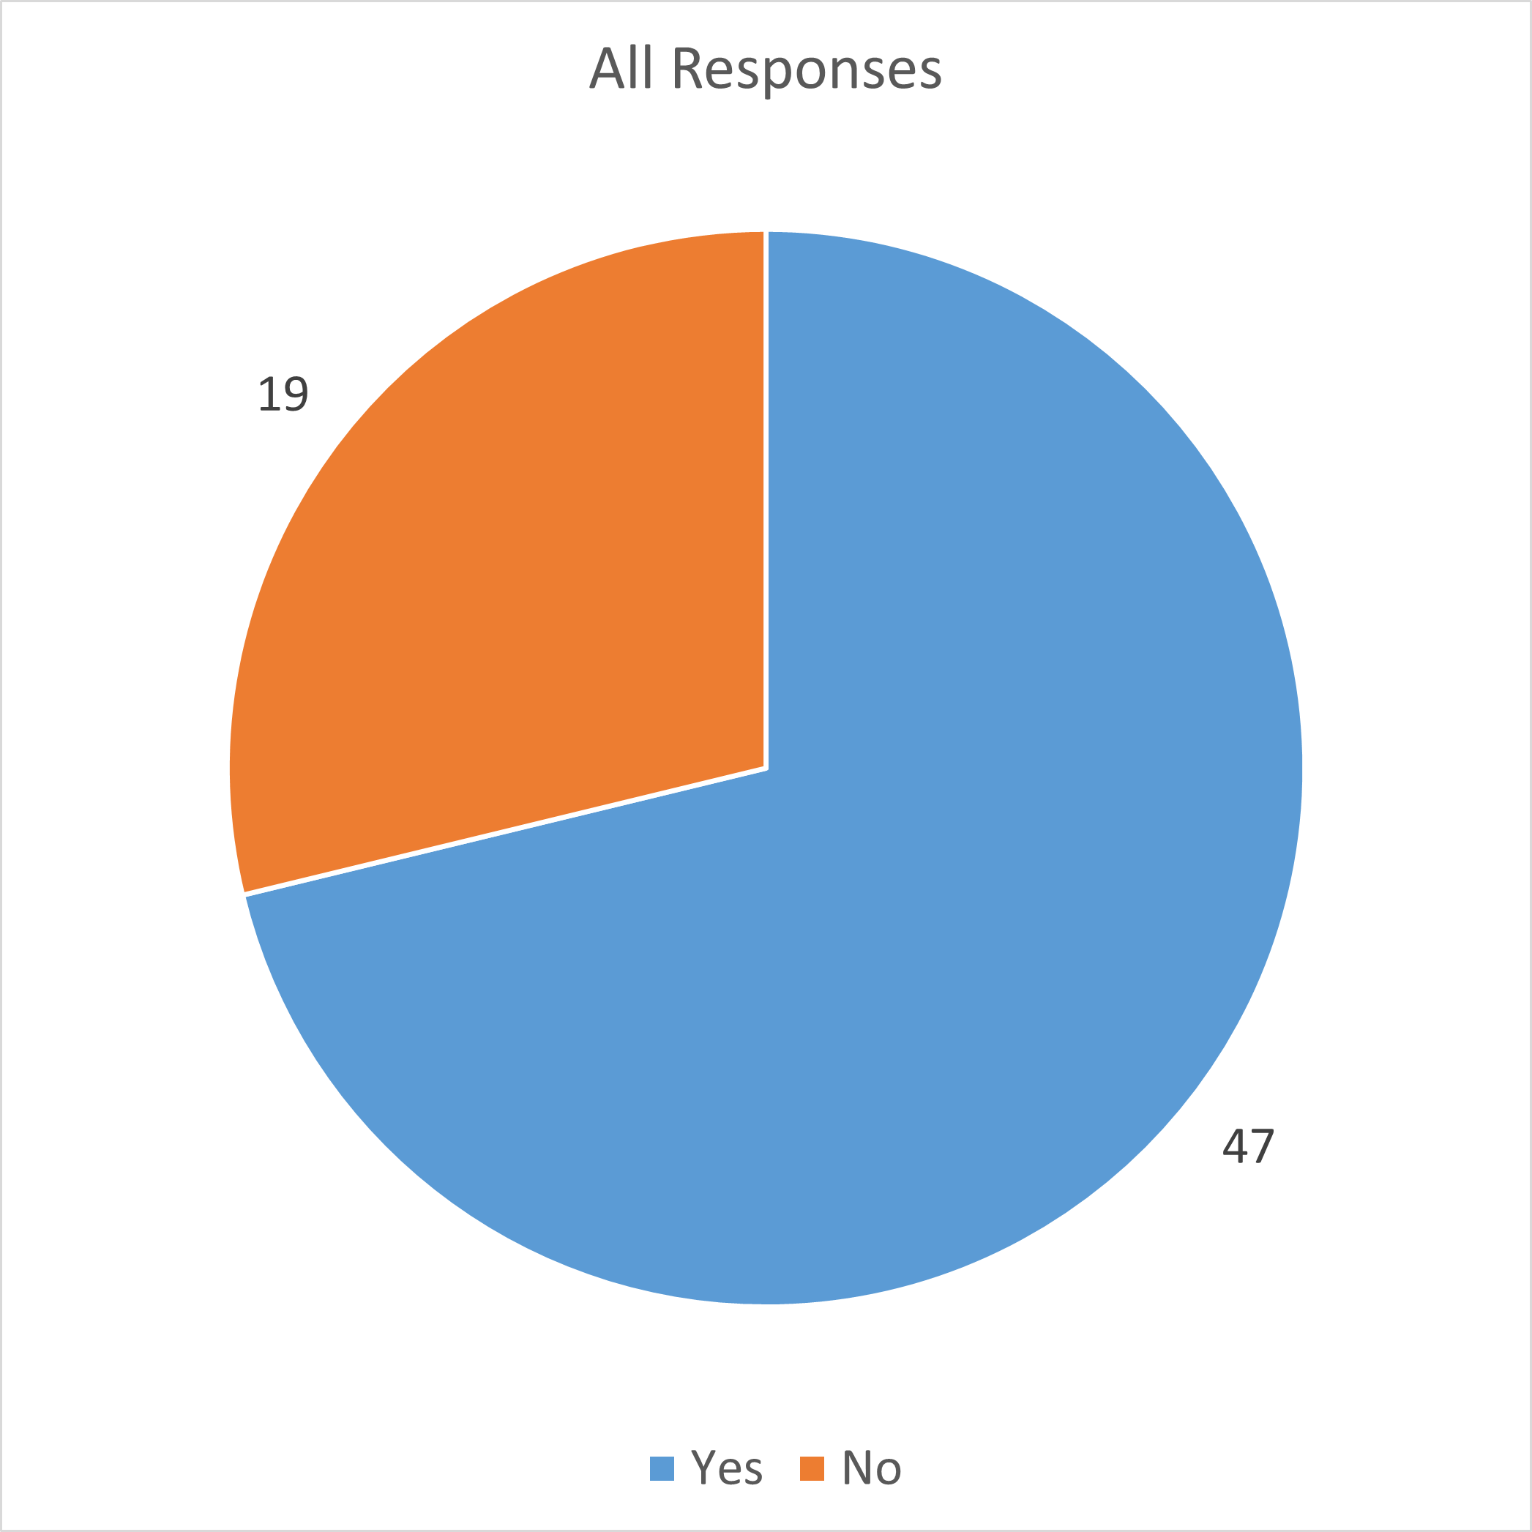
Poll Results
66 respondents
71.2% want the name changed

Slide 5
Poll Results
We requested information from respondents about why they believed the name should or should not be changed (open response) and their career description (open response)
We labelled the “why” statements by common themes (e.g., “I don’t see a problem with the ISIS name,” “I don’t feel strongly about it,” “This has impacted me personally”)
We labelled demographic responses by similar career description (see right)
Responses and labeling can be shared confidentially if needed
Demographic Labels
Research Scientist/Research Professor
Astro
Mission/Instrument Team Member
Other
Software/Pipeline Developer
Student (all levels)
Cartographer/Geodesist
Data Archivist
Miscellaneous
Notes:
Verbally note our labeling methodology

Slide 6
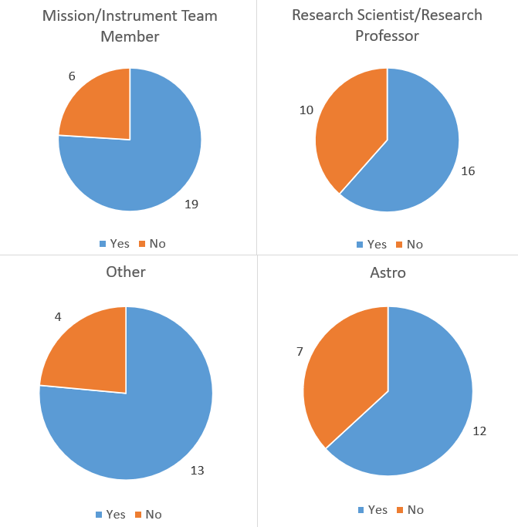
Poll Results
No significant variation with demographics we tracked: all agreed the name should be changed
Interpretation: This is the sentiment across the whole community and no group we tracked sees the matter in a fundamentally different way
Notes:
No demographic data was collected for Astro, so it’s a completely separate group
Point out that responses may have more than 1 label so numbers will not all add up to 66.

Slide 7
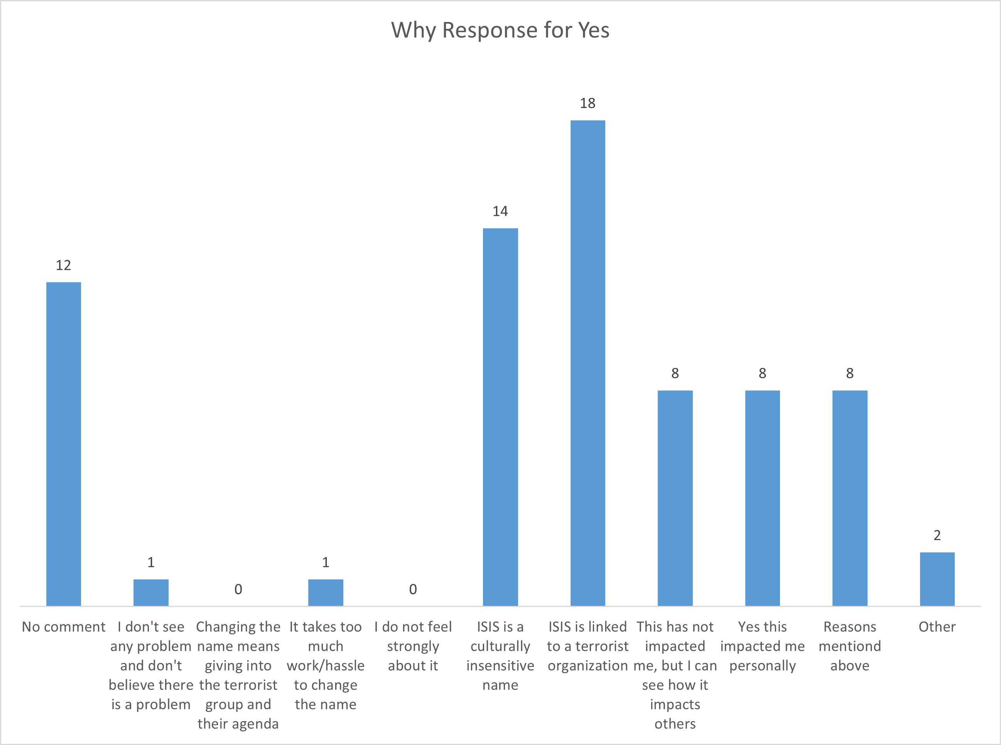
POLL RESULTS
Of the people who voted to change the ISIS name, the majority were concerned with the connection to the terrorist group, and they could see how this could cause significant problems. A significant number of respondents (12%) said they were directly impacted.
Interpretation: The polling supports the anecdotal evidence that a significant minority of the community is negatively impacted by the name.
Notes:
Most “culturally insensitive” responses were also labeled as “linked to a terrorist organization”, but not visa versa
All responds who were personally impacted said the name should be changed

Slide 8
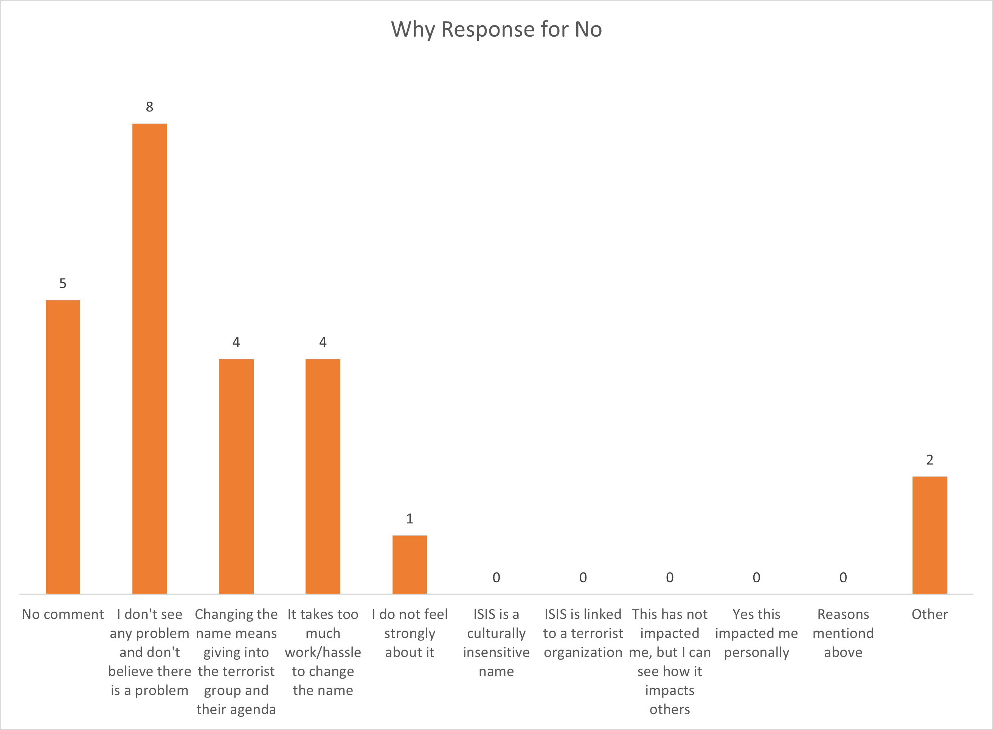
Poll Results
Of the people who voted to keep the ISIS name, the majority did not witness any issues with the name and did not believe that issues really existed.
Interpretation: This is typical when a ‘privileged’ group hears about a problem that does not affect them directly or those they typically interact with. This reflects a lack of interaction with the problem, rather than the absence of a problem.

Slide 9
RECOMMENDATION
The name should be changed.
All affected parties want it to be changed.
Those who do not want the change, do not see a problem.
Survey responses demonstrate there is a problem.

Slide 10
expected Impact
Changes within the software package
API breaking
Import/export apps
Environment variables
Changes to processing pipelines and training materials
USGS websites and external websites
Inconsistency between past and future manuscripts
Changes in communication
Notes:
One of the largest ”no” reasons was because of the effort required
Second bullet is caused by first bullet

Slide 11
SCOPE OF IMPACT
The effort required to change the name within the software is minimal compared to the effort required to:
Coordinate the changes
Communicate the changes
Transition everything around the software
Notes:
Rough estimate
Better to estimate the work for the change and mitigation

Slide 12
Impact MITIGATION
Unified Transition
Coordinate across the community
Clear and limited roll out period
Transition Guide
Consider developers, application users, and scientists
Cover how to update existing installations and multi-user environments
Communication Strategy
Cover all reasonable channels (press release, social media, conferences, mailing lists, etc.)
Work with publications and conferences to require the new name
Clear and concise explanation for the name change
Notes:
Focus on planning before execution

Slide 13
Recommended Future Actions
Move forward with changing the name
Task a group with developing a plan and estimating the effort for:
Choosing a new name
Implement the name change
Communicate the name change
The group should report back to the ISIS TC and USGS ASC management within 2022
Notes:
There was no consensus in the responses for what the new name should be.
Unified action
Resources for planning and communication
Very rough timeline:
Plan now and start of FY23
Communicate in FY23
Execute in FY24

